Slide 1
Classes and Objects

Slide 2
Class is a way to bind the data describing an entity and its associated functions together.
class Account { int accNo;
char type;
float balance;
public:
int a;
float deposit ( float amount)
{ balance+=amount;
return balance;
}
float withdraw( float amount)
{balance - =amount;
return balance;
}
};

Slide 3
Here the data describing the class Account ( accNo, type , balance) and its associated operations( deposit & withdraw) are bound together under one name Account

Slide 4
Need for classes
Classes are needed to represent real-world entities that not only have data type properties( their characteristics) but also have associated operations ( their behavior).

Slide 5
class Student {
public:
void accept(float m)
{ cin>> ID;
marks= m;
assign();}
void display()
{ cout<<ID<<marks<<grade; }
};

Slide 6
Student obj;
cin>>m;
obj.accept(m);
obj.display();

Slide 7
Declaration of classes
A class is a way to bind data and associated functions together.
The Internal data of a class is known as data members
The functions associated with the data is known as member functions.

Slide 8
Class members fall under one of the three different access permission category
Public member – are accessible by all class users
Private member - are only accessible by the class member within the class
Protected member – are only accessible by the class members and members of the derived class.

Slide 9
Class Definition
The general form of a class definition is as given below
class class-name
{ variable- declaration;
function declaration;
protected:
variable- declaration;
function declaration;
public:
variable- declaration;
function declaration;
};
By default the members in a class is private.

Slide 10
Q. Write the difference between class and structure. Explain with an example

Slide 11
Class Method definition
class Account { int accNo;
char type;
float balance;
public:
float deposit ( float amount)
{ balance+=amount;
return balance;}

Slide 12
Class Method definition
float withdraw( float amount)
{balance - =amount;
return balance;
}
};
// This is function defined inside the class

Slide 13
Member function defined outside class.
Syntax
return type class-name:: function-name( parameter)

Slide 14
class Account { int accNo;
char type;
float balance;
public:
float deposit ( float amount) ;
float withdraw( float amount);
};

Slide 15
float Account :: deposit ( float amount)
{ balance+=amount;
return balance;
}
float Account :: withdraw( float amount)
{balance - =amount;
return balance;
}

Slide 16
Objects
Objects are the variables of a user defined data type class.
In other words, class acts as the data type
and objects as its variable.
For eg :
To declare an object of class Amount is:
Amount a;

Slide 17
Accessing class members
The class members that are declared public can be accessed from outside the class
ObjectName.FunctionName(Parameter);
Functions can be defined
Inside the class
Outside the class

Slide 18
#include<iostream.h>
class Transport
{ char Mode[20];
int N=0;
char Name[20];
void Get()
{ gets(Mode); gets(Name); }
void Show()
{ cout<<Mode<<endl <<Name<<endl; }
}
void main()
{ transport T;
T.Get();
T.Show();
}
Notes:
Rewrite the program after removing syntactical error

Slide 19
Array of objects
class Emp
{ int m;
char name[10];
public:
void accept( )
{ cin>>m; gets(name); }
void display( )
{ cout<<m<<name; } } obj[10];

Slide 20
Array of objects
void main( )
{ int s;
cout<<“Enter the number of Objects”;
cin>>s;
for(int i=0;i<s;i++)
{ obj[i].accept( ); }
for(i=0;i<s;i++)
{ obj[i].display( ); } }

Slide 21
Q Define a class report with the following specification
Private member :
admin, name, marks, average,
getAvg()- to compute the average obtained in five subjects
Public member :
read() - function to accept values and invoke the function getAvg().
display() – function to display all the data members on the screen

Slide 22
Q Declare a class to represent bank account of 5 customer with the following data members.
Name of depositor, Account number, Type of account( S for saving & C for current), Balance amount.
The class should contain the member functions to do the following :
to Accept data members
to deposit money
to withdraw money ( minimum balance should be 1000)
to display the data members.

Slide 23
Q Define a class called Library for the following specification
Private member :
Name as string
eBook,pBook,mBook as int
Price as float
total as int
retTotal calculates the number of all the books and returns the value should be stored in total
Public:
read() – accepts all the data.
calcTotal() – which invoke retTotal function and calculates the Price total
5000 >45
3500 30-44
2500 15-29
2000 <15
print() – prints all the data.

Slide 24
GLOBAL & LOCAL CLASS OBJECT
A class is said to be global class, if its definition occurs outside the bodies of all the functions in a program, which means that object of this class can be declared anywhere in the program.
class X
{ ……
};
X obj;
void main()
{ X obj1;}
void fun()
{ X obj2; }
Global class
Global object of class X
Local object obj1 only available in main program
Local object obj2 only available in function fun

Slide 25
A class is said to be local class if its definition occurs inside a function body, which means that the object of this class type can be declared only within the function that defines this class type.
void main()
{ class Y Local class
{ ….. };
Y ob1; Local object ob1
}
void fun()
{ Y ob2; }
Invalid

Slide 26
TYPES OF CLASS FUNCTIONS
ACCESSOR FUNCTION
These are the functions that allow us to access the data members. Accessor functions do not change the values of the data members.
MUTATOR FUNCTION
These are the member functions that allow us to change the data member of a class.
MANAGER FUNCTION
These are the member functions that deals with initializing and destroying class instances (ie constructors & destructors).

Slide 27
class Stud
{ int rno; char g; float mark;
public:
void read()
{ cin>>rno>>marks; }
void display()
{ cout<<rno<<mark<<g;}
void calc()
{ if(marks>90)
g=‘A’;
:
:
}
};
Accessor function :
read, display
Mutator function :
calc

Slide 28
Memory Allocation of Objects
Member functions are created and placed in the memory space only once when the class is defined.
Separate memory space is allocated to the objects at the time of their declaration for their data members only, because the data members hold different values for different objects.
No separate space is allocated for member functions when the objects are created.

Slide 29
Nested class
A class may be declared within another class. A class declared within another is called a nested class.
The outer class is known as the enclosing class and
inner class is known as nested class.
#include<iostream.h>
class Outer { int a;
class Inner
{ int b;
public:
int c;
void prn()
{ cout<< “ Inside Inner class prn() “<<endl;
cout<<b<<“ \t”<<c<<endl; }
};

Slide 30
ARRAY OF OBJECTS
class student
{ int rno ; char name[10]; float mark;
public:
void accept()
{ cin>> rno; gets(name); cin>> mark; }
void display()
{ cout<<rno <<“ \t”<<name<<“\t”<<mark; }
};

Slide 31
void main()
{ student st[10];
int n, i;
cout<<“Enter the number of students :”; cin>>n;
for(i=0;i<n;i++)
{ cout<<“Enter the details of :”<<i+1<<“student”;
}
for(i=0;i<n;i++)
{ cout<<“Details of :”<<i+1<<“student”;
}
st[i].accept() ;
st[i].display() ;

Slide 32
accept ()
display()
st[0]
Rno
Name
marks
st[1]
Rno
Name
marks
st[2]
Rno
Name
marks

Slide 33
Highest mark
class student
{ int rno ; char name[10]; float mark;
public:
void accept()
{ cin>> rno; gets(name); cin>> mark; }
void display()
{ cout<<rno <<“ \t”<<name<<“\t”<<mark; }
float retmark()
{ return mark }
};

Slide 34
void main()
{ student st[10];
int n, i;
cout<<“Enter the number of students :”; cin>>n;
for(i=0;i<n;i++)
{ cout<<“Enter the details of :”<<i+1<<“student”;
st[i].accept(); }
for(i=0;i<n;i++)
{ cout<<“Details of :”<<i+1<<“student”;
st[i].display(); }

Slide 35
float lar=st[0].retmark();
int flag=0;
for(i=1;i<n;i++)
{ if(lar<st[i].retmark())
{ lar=st[i].retmark();
flag=i; }
}
cout<<“The student with maximum mark is”;
st[flag].display();
}

Slide 36
search for a roll number
class student
{ int rno ; char name[10]; float mark;
public:
void accept()
{ cin>> rno; gets(name); cin>> mark; }
void display()
{ cout<<rno <<“ \t”<<name<<“\t”<<mark; }
float retmark()
{ return mark }

Slide 37
void search(int a)
{ if(a==rno)
{ cout<<“ Roll number found :”
display();
return(1);
}
return 0;
}
};

Slide 38
void main()
{ student st[10];
int n, i;
cout<<“Enter the number of students :”; cin>>n;
for(i=0;i<n;i++)
{ cout<<“Enter the details of :”<<i+1<<“student”;
st[i].accept(); }
for(i=0;i<n;i++)
{ cout<<“Details of :”<<i+1<<“student”;
st[i].display(); }

Slide 39
int num, flag=0;
cout<<“Enter the roll number to be searched “;
cin>>num;
for(i=0;i<n;i++)
{ if( st[i].search(num)==1)
{ flag=1; break; } }
if(flag==0)
cout<<“Roll number doesnot exist “;
}

Slide 40
Program search for a roll number and change the mark of that roll number.
Program to enter unique roll number (no repetition of roll number)

Slide 41
TYPES OF CLASS FUNCTIONS
ACCESSOR FUNCTION
These are the functions that allow us to access the data members. Accessor functions do not change the values of the data members.
MUTATOR FUNCTION
These are the member functions that allow us to change the data member of a class.
MANAGER FUNCTION
These are the member functions that deals with initializing and destroying class instances (ie constructors & destructors).

Slide 42
Nested Class
A class may be defined within another class. this is known as nested class.
The outer class is known as enclosing class and the inner class is known as nested class.

Slide 43
Nested class
#include<iostream.h>
class Outer { int a;
class Inner
{ int b;
public:
int c;
void assign()
{ b=5; c=10; }
void prn()
{ cout<< “ Inside Inner class prn() “<<endl;
cout<<b<<“ \t”<<c<<endl; }
};
Inner ob1;
public:
Inner ob2;
void assign2()
{ a=25;}
void second()
{ cout<<“ In the Outer class “<<endl;
cout<< ob2.b<<ob2.c<<a<<endl; }
};

Slide 44
void main()
{ Outer ab;
ab.assign2();
ab.ob2.assign();
ab.second()
ab.ob2.prn()
}
output:

Slide 45
All classes including enclosing classes and nested classes obey the usual access rule.
The member functions of a nested class have no special access to members of an enclosing class.
That is the nested class can access public member of its enclosing class using an object only.
The access to private and protected member is not available to other class

Slide 46
Data Hiding and Encapsulation
The part of the class that is been hidden from the outside world( i.e private and protected ) supports data hiding.
Abstraction refers to the act of showing only the essential features without including the background details or explanation( i.e the public area in a class)
Abstraction supports data hiding so that only the relevant information is exposed to the user and the rest of the information is hidden from the user.
Encapsulation is the wrapping up of data and the associated member functions into one unit.

Slide 47
Inline functions
The inline functions are designed to speed up the programs
The coding of normal function and inline functions are similar except that inline function definition start with the keyword inline.

Slide 48
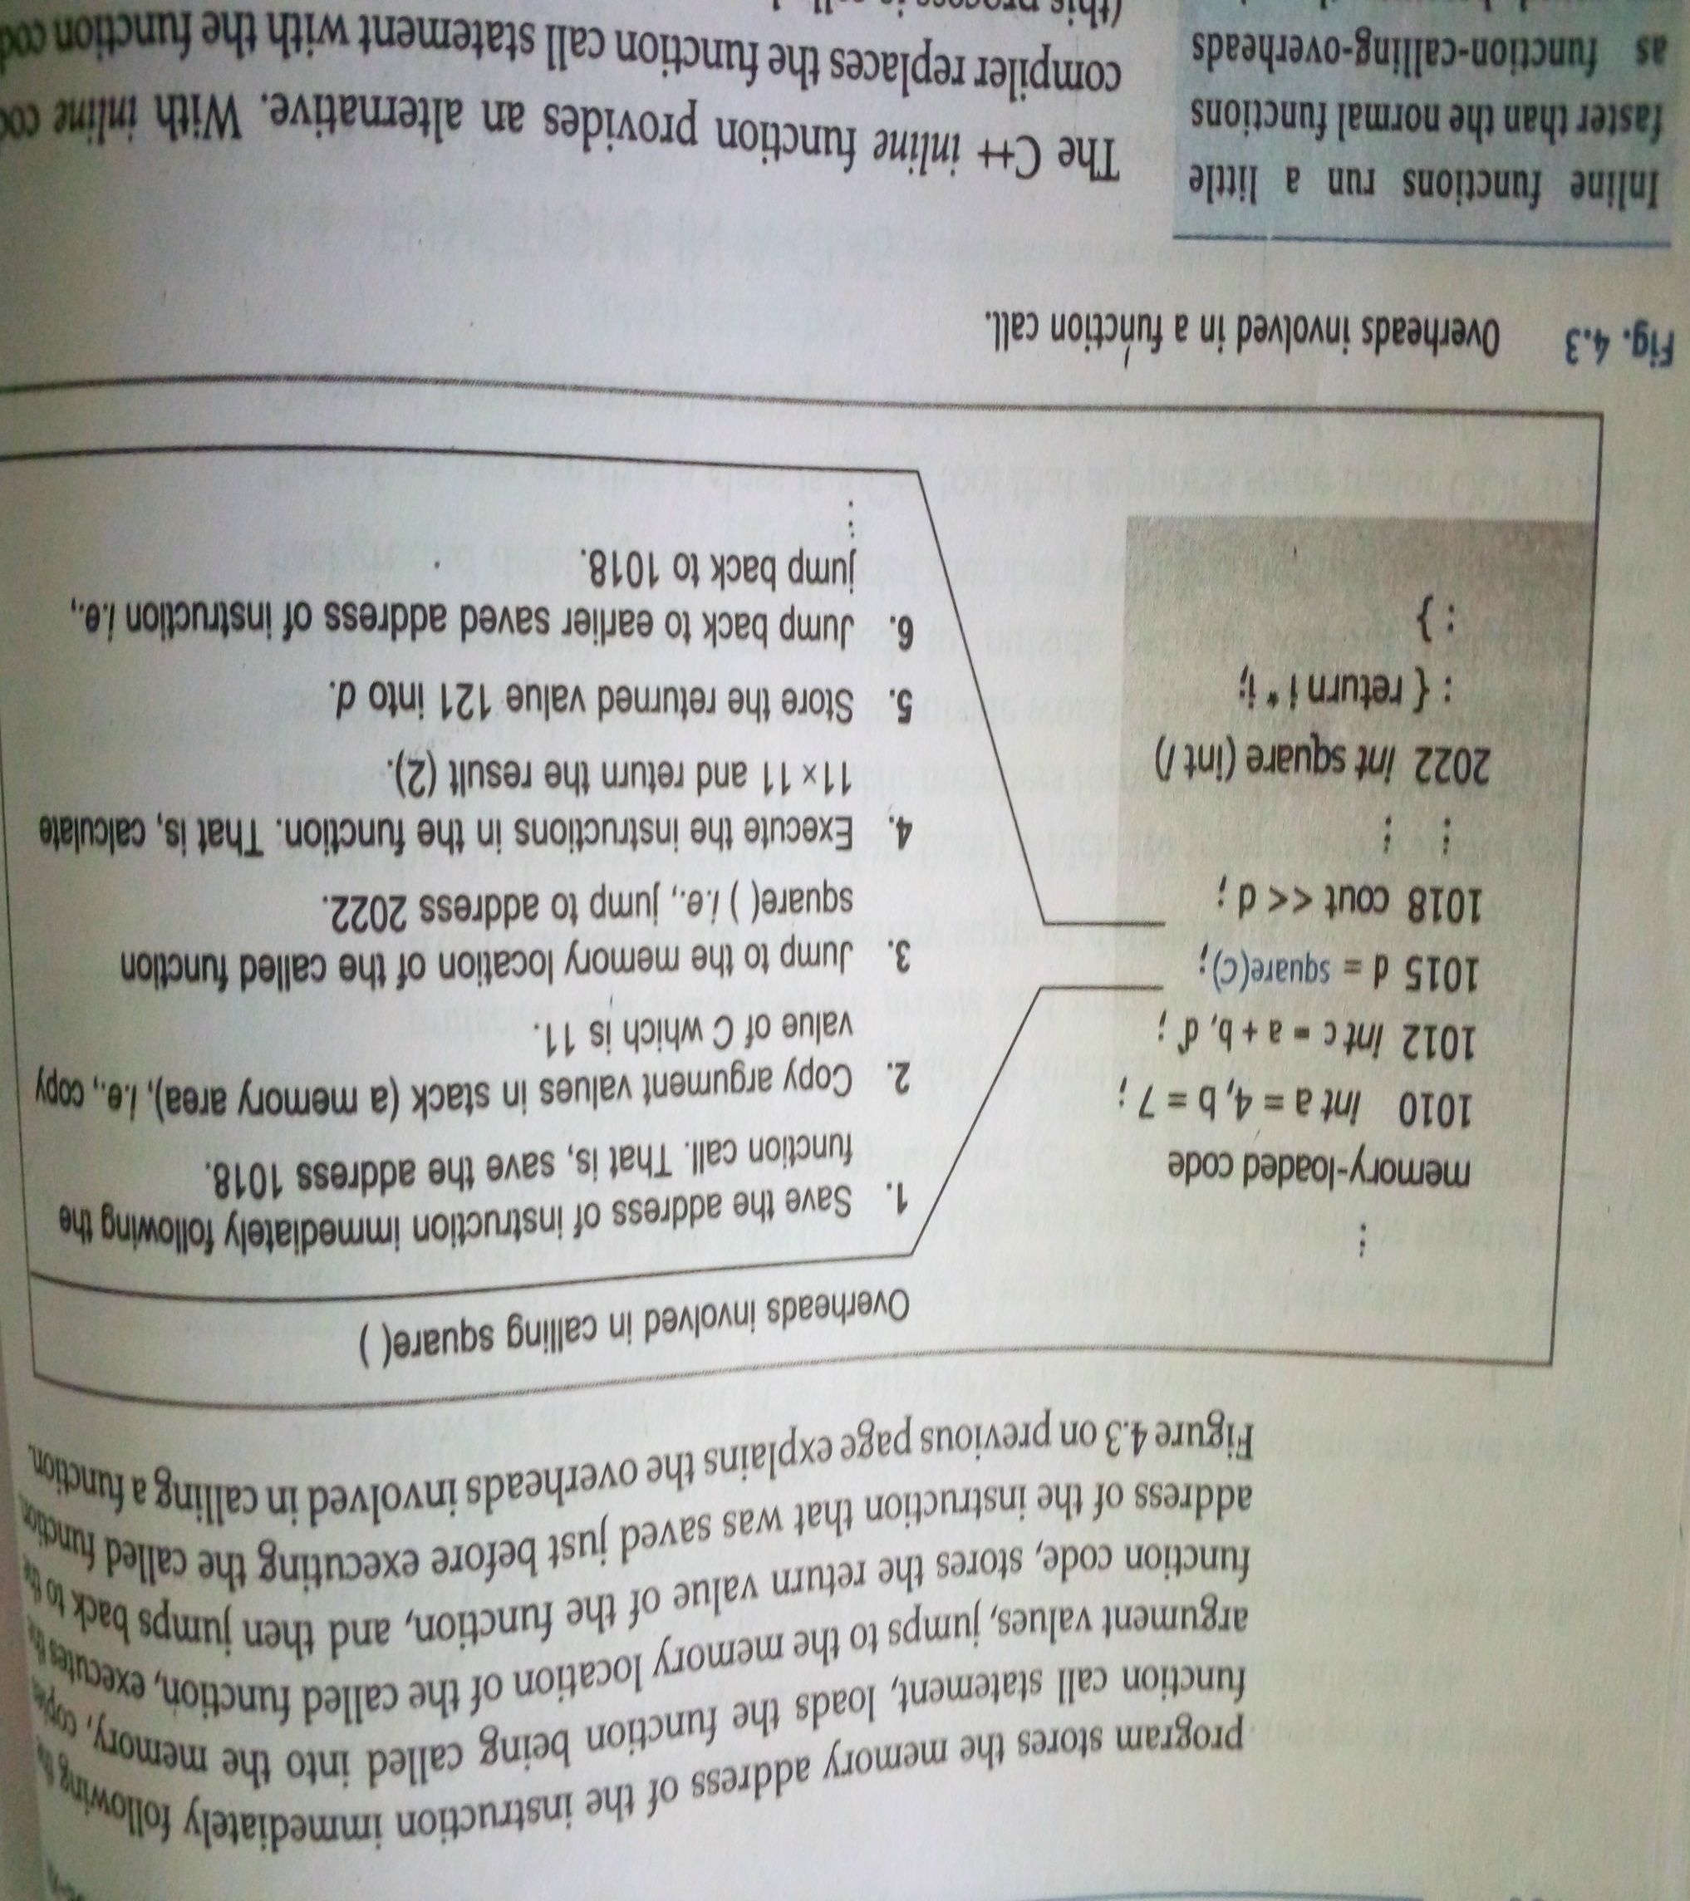
Working of a normal function

Slide 49
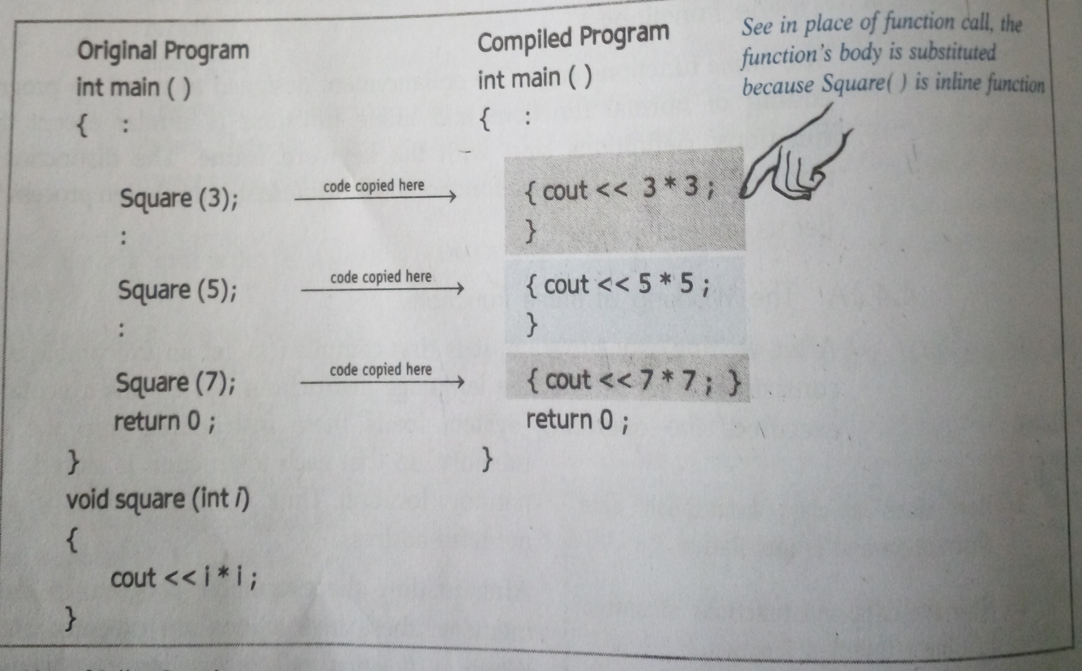
Working of inline function

Slide 50
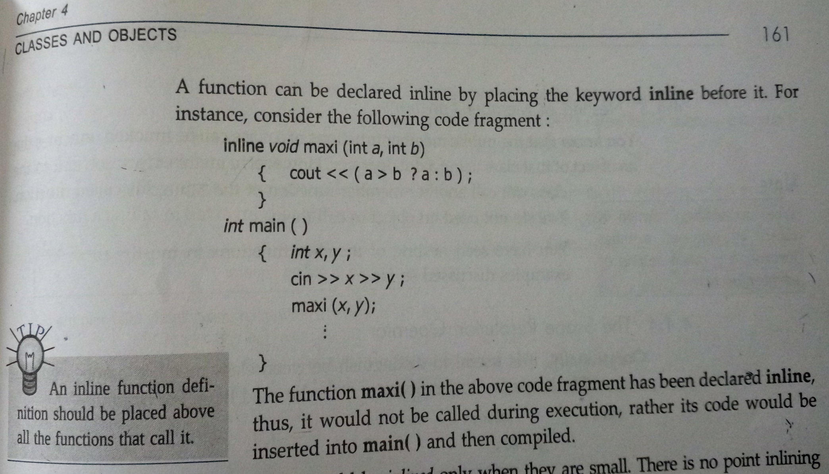
How to define an inline function?

Slide 51
The function should be inlined only if the code is small
The function inlining will not work in the following cases
For functions that return values and have a loop or a switch or a goto.
If the functions contain static variables.
If the function is a recursive ( a function that calls itself)

Slide 52
Constant member function
If the member function of a class does not alter any data in the class, then this member function is called as constant member function using the keyword const.
eg
int maxi(int, int) const;
void prn() const;
The qualifier const will appear in both the function declaration and definition.

Slide 53
Nesting of member function
When the member function of the same class calls another member function of the same class then it is called nesting of member functions.

Slide 54
Objects as Function Arguments
There are two ways to pass the objects
Call by value
call by reference

Slide 55
Call by value
class Time { int h,m,s;
public:
void get_time(int hr,int min,int sec)
{ h=hr; m=min; s=sec; }
void put_time()
{ cout<<h<<“:”<<m<<“:”<<s; }
int gethr(){ return h;}
int getmin() { return m;}
int getsec() { return s;}
};

Slide 56
void sum(Time t1, Time t2);
// add both the time and store in T1
void convert(Time t1,char ch);
//time in hr or time in am/pm

Slide 57
void main()
{ Time tm1, tm2;
tm1.get_time(5,12,45);
tm2. get_time(7,2,15);
convert(tm1,ch);
sum(tm1,tm2);
prnvalues(tm1);
}

Slide 58
Call by Reference
class Time { int h,m,s;
public:
void get_time(int hr,int min,int sec)
{ h=hr; m=min; s=sec; }
void put_time()
{ cout<<h<<“:”<<m<<“:”<<s; }
int gethr() { return h;}
int getmin() { return m;}
int getsec() { return s;}
};

Slide 59
void sum(Time &t1, Time &t2);
// add both the time and store in T1
void convert(Time &t1,char ch);
//time in hr or time in am/pm

Slide 60
void main()
{ Time tm1, tm2;
tm1.get_time(5,12,45);
tm2. get_time(7,2,15);
convert(tm1,ch);
sum(tm1,tm2);
prnvalues(tm1);
}

Slide 61
Function returning an object
void convert(Time &t1,char ch);
//time in hr or time in am/pm
Time convert ( Time &t1, char ch)
{ ………………
return (t1) ; }
Function call :
Time T=convert(t1,ch);

Slide 62
Static Class members
A static data member is just like a global variable for its class.
That is , this variable is available for all the objects of that class.
obj1
obj2
obj3
int a

